Slide 1
CONCEPTS OF PERCEPTION AND CRITICAL THINKING
Perception can be defined as the ability to become aware of something through the five senses, the way in which something is regarded understood or interpreted or intuitive understanding and insight.

Slide 2
HOW SENSES IMPACT PERCEPTION
There are five basic senses associated with humans; touch, sight, hearing, smell and taste. The sensing organs associated with each sense relay information to the brain, which is responsible for sorting out and integrating the signals, allowing us to perceive the world and interact with our environment.
Notes:
We perceive the world around us through the five senses; touch, sight, hearing, smell and taste. They are responsible for everything that enters the brain. David Poepppel, a professor of psychology said: ‘Historically, the way we intuitively think about perception is that we are like a passive recording device with decoders that are specialized for certain things,like a retina for seeing, a cochlea for hearing and so forth.’

Slide 3
Analysis
THE EYE
Responsible for the sense of sight, the eye is the most complex of the senses and provides the most data to the brain. Light vibration through the eye is converted to an image in the brain, which process images to permit quick recognition of things we see.
THE EAR
Detects the audible universe. The ear senses vibrations of the air which the brain converts to sound. The brain builds a large database of sounds which permit us to identify people and places.
THE NOSE
The nose is well positioned to smell in front of us. Nose tissues sense airborne chemicals which the brain converts to the perception of smell.
Notes:
The eye, the ear and the nose all have sensory elements that provide the brain with various signals depending on the environment. The brain is able to understand and act on the signals to permit quick recognition and identification of various elements in our environment. These senses go a long way in acknowledging what is around us.

Slide 4
THE SKIN
The skin is a sensory organ whose nerves constantly send signals to the brain. The interpretation of these signals provides the sense of touch. The perception of contact helps in distinguishing a variety of feelings.
THE TONGUE
The surface of the tongue senses chemicals in the food we eat. The brain converts the information from the tongue into the sensation of taste.
Notes:
The sense of touch is said to be the first sense developed in humans. Skin nerves consistently send signals to the brain depending on our environmental conditions. The tongue also senses whatever is present in the food we eat and conveys it to the brain. We are thus able to react to the taste of the food as controlled by the brain receptors.

Slide 5
ROLE OF PERCEPTION IN CRITICAL THINKING
Critical thinking begins when one recognizes the limitations of their various perceptions. For one to adopt critical thinking, they must first acknowledge their take on reality. This provides an opportunity to critically reflect on their subjectivity and measure it against wider evidences and alternative perceptions.
Observing any topic from multiple perspectives is key in the process of critical thinking. Having the same thought in the minds of different people with different perspectives would result to varying end results. Critical thinking largely incorporates the concept of observation from multiple perspetives.
Notes:
Perceptions largely affect the way we think. It provides a starting point of thinking and influences our mental health and experiences or comparisons. Since perception limits what we are able to know, it largely influences critical thinking. You can only think what you perceive.

Slide 6
Kaye A. Peters says, ‘Our thoughts, attention and intention create our choices and actions which create our world. It is all in perception and how we respond or react to what is presented to us.’ The freedom of choice and deductive reasoning all affect critical thinking. What we think is our reality is how we respond. We must therefore view ideas or concepts in different perspectives to be able to get the concept of reality, and that is critical thinking.
Notes:
Being open minded to things surrounding us, and viewing them in different lights exposes us a whole world of reality. Your senses being bombarded with information, your perspective should enable you to choose the useful ones and ignore irrelevant input. This is enabled by critical thinking.

Slide 7
REFERENCES
https://www.sciencedaily.com
https://www.livescience.com
https://www.quora.com

Slide 8
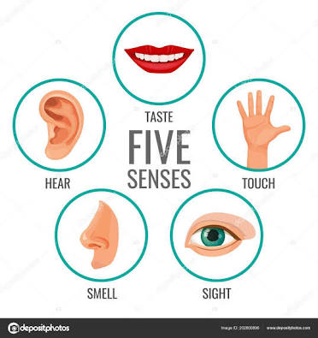
Notes.
The ability to sense whatever is happening around your environment, with the aid of the five senses is called perception Theree are only five senses: Touch, hearing, smell, Taste and sight.

